Slide 1
custom widget example
CPE EMED

Slide 2
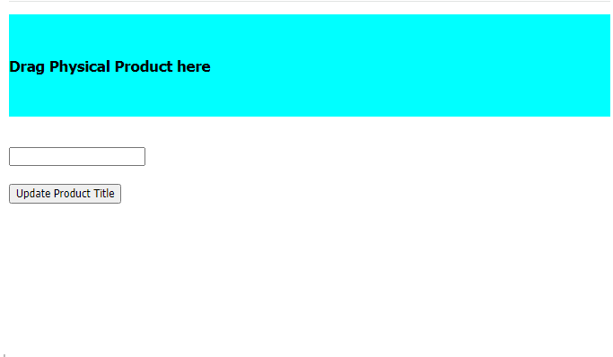
Overview
Custom Widget – Sample
  Not production ready
  Minimal UI
  Source code will be shared on GitHub
Functionality
  Allows updating of the Title of a Physical Product
  3DEXPERIENCE Web Services
    Get Engineering Item Details
    Get CSRF Token
    Update Engineering Item Property (Title)
NodeJS Express Webserver – hosted in Azure
  Server
  Client
Uses Javascript API to call 3DEXPERIENCE Web Services (WAFData)

Slide 3
Example Architecture
Index.html
  User Interface definition
Main.js
  Business Logic functions
Utils.js
  Wrappers around WAFData
Index.html
Custom Widget
Main.js
Utils.js
Javascript API (WAFData)
3DEXPERIENCE Web Services

